Slide 1
Company Registration Data Analysis
ANALYTICAL APPROACH
Turnover, sector, incorporation and geographic patterns
1
Data quality
Checked missing values and duplicates.
50,501 companies analysed after data-quality checks and removal of duplicate and aggregate Summary records.
2
Cleaning
Removed 9 duplicate rows and 10 Summary aggregate rows.
3
Feature engineering
ORIGINAL RECORDS
FINAL RECORDS
BUSINESS QUESTIONS
Average turnover, incorporation year/month and year-on-year growth.
50,520
50,501
4
Before cleaning
Used for company-level analysis
Answered with Python analysis
4
Business questions
Compared sector performance, incorporation patterns, turnover consistency and geography.

Slide 2
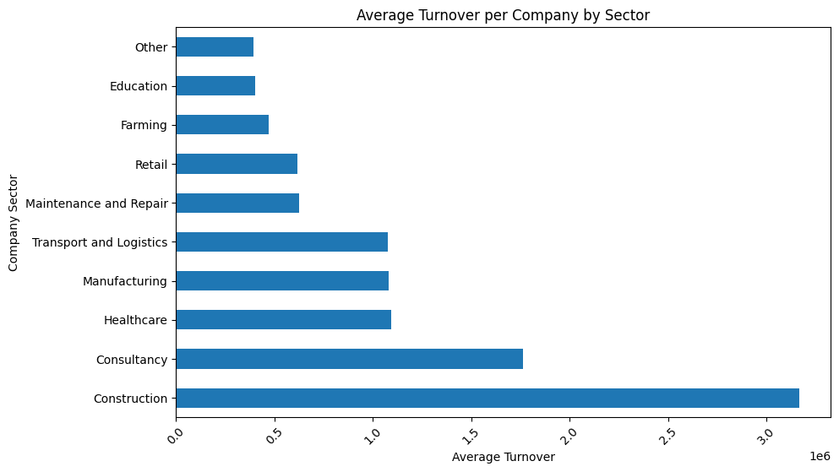
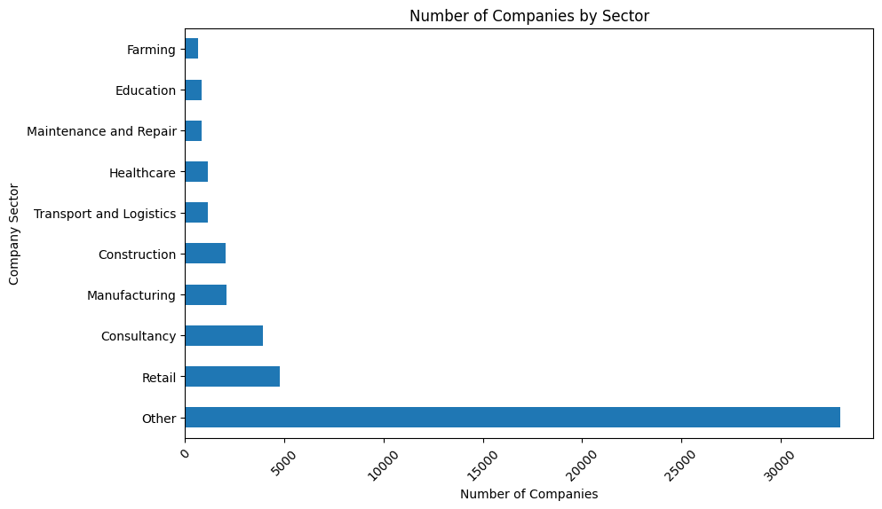
Q1 | Which sector has the highest average turnover per company, and how does this compare to the sector with the most companies registered?
HIGHEST AVERAGE TURNOVER
MOST COMPANIES
KEY COMPARISON
Construction — £3.17m
Other — 33,026
Not the same sector
Average turnover per company
65.4% of the cleaned dataset
High company volume does not imply highest average turnover
Notes:
.

Slide 3
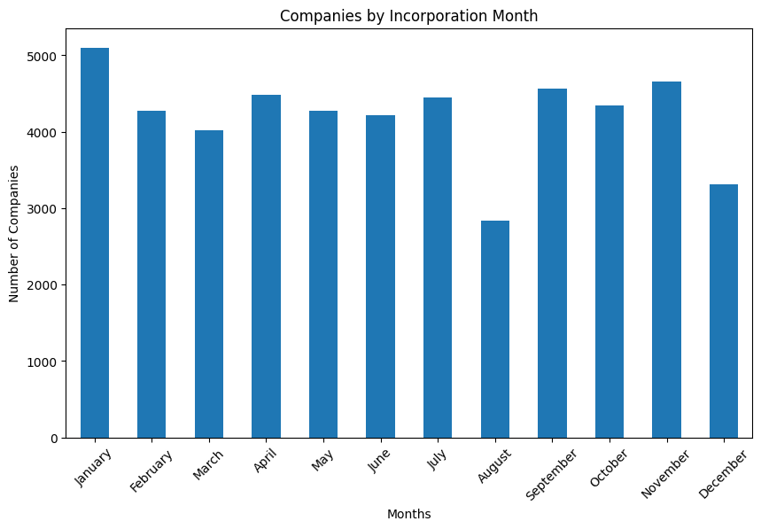
Q2 | What is the most common month for a business to incorporate, and is this consistent across different sectors?
MOST COMMON MONTH
SECTORS PEAKING IN JANUARY
January
4 of 10
Consultancy, Education, Other and Retail
5,101 companies
PEAK MONTH BY SECTOR
Sector | Peak month
Construction | November
Consultancy | January
Education | January
Farming | April
Healthcare | September
Maintenance & Repair | May
Manufacturing | April
Other | January
Retail | January
Transport & Logistics | November
January is the most common month overall, but the pattern is not uniform across sectors.

Slide 4
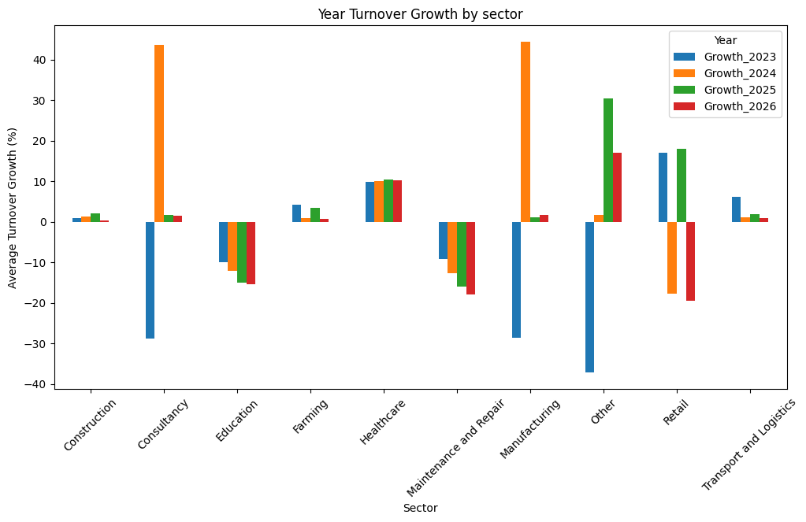
Q3 | Which sector shows the most consistent change in turnover year-on-year across the full period, and what does this suggest about that sector’s future performance?
MOST CONSISTENT
Healthcare
Growth stayed close to 10% in every year-on-year period.
Period | Growth
2023 | 9.8%
2024 | 10.0%
2025 | 10.4%
2026 | 10.2%
Growth variation
0.256 percentage points
This indicates historically predictable turnover growth, although it does not guarantee future performance.

Slide 5
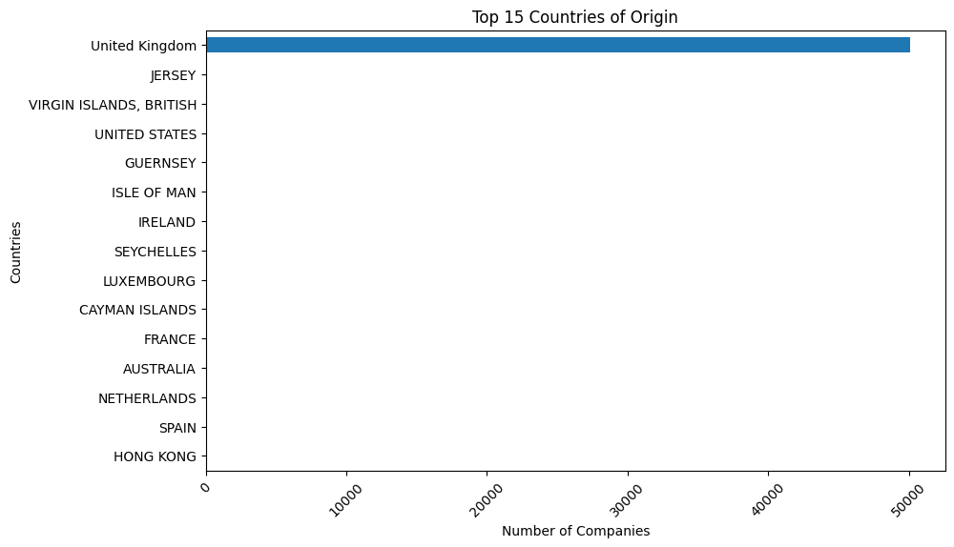
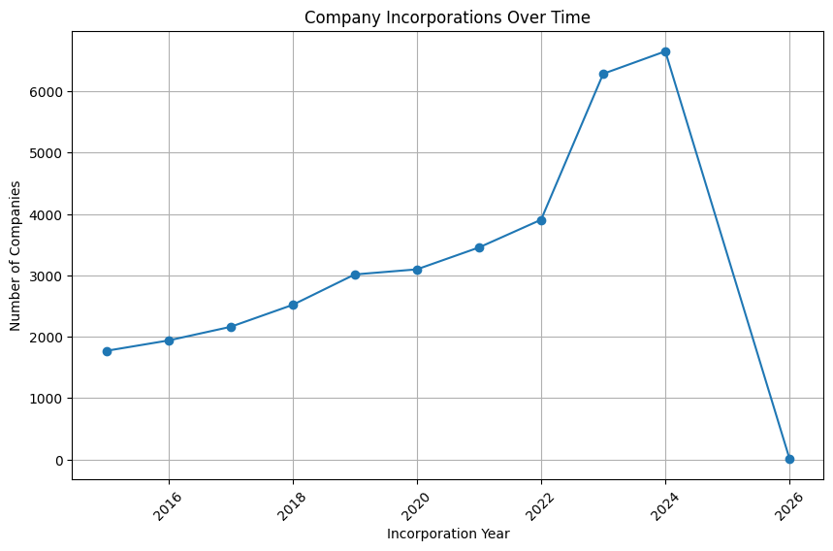
Q4 | What other conclusions can be drawn from the data. We are particularly interested in trends over time, and comparisons between different geographic areas.
UK CONCENTRATION
HIGHEST OBSERVED COUNTRY AVERAGE
RECENT INCORPORATION TREND
50,093 companies
Sweden — £1.84m
3,456 → 6,653
99.2% of the cleaned dataset
2021 to 2024; 2026 has only 12 records

